Slide 1





Module 05- Classes and Objects
WWW.SELACLOUD.COM

Slide 2

Agenda
Classes explanation and example
Creating Instances
Hide Implementation
Class destructors
Class Inheritance
Override base class methods

Slide 3
Class
Python defines a set of predefined types of objects, like int, string, list, method etc.
User can define its own, user defined type of object using class keyword
The name of the class immediately follows the keyword class followed by a colon. The name of class is a new user defined type:
class Test:
'Optional class documentation string'
pass
Notes:
As mentioned above the basic Python data structures in Python include list, set, tuples, and dictionary.
Each of the data structures is unique in its own way. Data structures are “containers” that organize and group data according to type.
The data structures differ based on mutability and order.
Mutability refers to the ability to change an object after its creation. Mutable objects can be modified, added, or deleted after they’ve been created, while immutable objects cannot be modified after their creation.
Order, in this context, relates to whether the position of an element can be used to access the element.

Slide 4
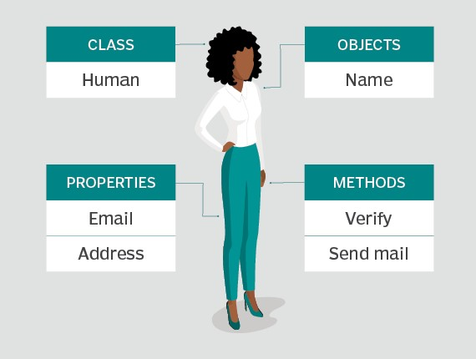
Class – cont’d
Python classes can contain different attributes, like methods, data members, docstring, etc
classes may define special methods, with predefined names and meaning and format like __XXX__.
They usually used for operators overloading and built-ins overriding
They are automatically invoked
For example:
__init__ - responsible for class instantiation for the newly-created class instance
__str__ - returns string representation of an object

Slide 5
self in Class’s methods
Python implements methods in a way that makes the instance, to which the method belongs, be passed automatically, but not received automatically
The first parameter of methods is the instance the method is called on
This parameter usually called self
Notes:
A list is defined as an ordered collection of items, and it is one of the essential data structures when using Python to create a project.
The term “ordered collections” means that each item in a list comes with an order that uniquely identifies them.
The order of elements is an inherent characteristic that remains constant throughout the life of the list.
Since everything in Python is considered an object, creating a list is essentially creating a Python object of a specific type.
When creating a list, all the items in the list should be put in square brackets and separated by commas to let Python know that a list has been created.
A sample list can be written as follows:
List_A = [item 1, item 2, item 3….., item n]
Lists can be nested
A list can be nested, which means that it can contain any type of object. It can include another list or a sublist – which can subsequently contain other sublists itself. There is no limit to the depth with which lists can be nested. An example of a nested list is as follows:
List_A = [item 1, list_B, item 3….., item n]
Lists are mutable
Lists created in Python qualify to be mutable because they can be altered even after being created. A user can search, add, shift, move, and delete elements from a list at their own will. When replacing elements in a list, the number of elements added does not need to be equal to the number of elements, and Python will adjust itself as needed.
It also allows you to replace a single element in a list with multiple elements. Mutability also enables the user to input additional elements into the list without making any replacements.

Slide 6
BankAccount

Slide 7
class BankAccount Example
Lets create Bank Account class
class BankAccount(object): commission = 5.40 # class variable shared by all instances def __init__(self, client_name, client_id, balance): self._client_name = client_name self._client_id = client_id self._balance = balance def withdraw(self, amount): if self._balance - amount > 0: self._balance -= (amount + BankAccount.commission) return True return False def deposit(self, amount): self. _balance += amount - BankAccount.commission return True def __str__(self): return "client: {} has {} $".format (self. _clientName, self. _balance);

Slide 8
class BankAcount – explanation
The variable commission is a class variable whose value would be shared among all instances of a this class – static attribute
It can be accessed as BankAccount.commission from inside or outside the class.
The first method __init__() is a special method automatically called by python to initialize newly-created class instance
Notes:
In Visual Studio we’re able to view web pages. This is done by selecting “Web Browser” from the View menu (View --> Other Windows --> Web Browser) and typing the requested URL in the URL dropdown menu.
We can switch between tabs by clicking on the desired tab.

Slide 9
Creating Instances
To create a new instance of a class simply specified a class name with all its parameters and assigned the result to some variable
ba = BankAccount(“Tal Moshe”, 12345678, 1000)
This statement invokes the __init__ method
Now we can access all the instance attributes
ba.deposit(500)
print(ba) #prints Tal Moshe has 493.60 $”
Notes:
Dictionaries are Python’s implementation of a data structure that is more generally known as an associative array. A dictionary consists of a collection of key-value pairs.
Each key-value pair maps the key to its associated value.
You can define a dictionary by enclosing a comma-separated list of key-value pairs in curly braces ({}). A colon (:) separates each key from its associated value:
MLB_team = { ... 'Colorado' : 'Rockies', ... 'Boston' : 'Red Sox', ... 'Minnesota': 'Twins', ... 'Milwaukee': 'Brewers', ... 'Seattle' : 'Mariners' ... }
Of course, dictionary elements must be accessible somehow. If you don’t get them by index, then how do you get them?
A value is retrieved from a dictionary by specifying its corresponding key in square brackets ([]):
>>> MLB_team['Minnesota'] 'Twins' >>> MLB_team['Colorado'] 'Rockies'
Defining a dictionary using curly braces and a list of key-value pairs, as shown above, is fine if you know all the keys and values in advance. But what if you want to build a dictionary on the fly?
You can start by creating an empty dictionary, which is specified by empty curly braces. Then you can add new keys and values one at a time:
>>> person = {} >>> type(person) <class 'dict'> >>> person['fname'] = 'Joe' >>> person['lname'] = 'Fonebone' >>> person['age'] = 51 >>> person['spouse'] = 'Edna' >>> person['children'] = ['Ralph', 'Betty', 'Joey'] >>> person['pets'] = {'dog': 'Fido', 'cat': 'Sox'}
>>> person {'fname': 'Joe', 'lname': 'Fonebone', 'age': 51, 'spouse': 'Edna', 'children': ['Ralph', 'Betty', 'Joey'], 'pets': {'dog': 'Fido', 'cat': 'Sox'}}

Slide 10
Lab 01-02

Slide 11
Hide Implementation
Python defines private attributes by convention
Attributes, whose name starts with an underscore (e.g. _spam) should be treated as a non-public and should be never accessed outside the class
Attributes, whose name starts with two leading underscores (e.g. __spam) will be treated as strongly private (Python simply changes their names in outside class access)
It is still possible to access or modify a variable that is considered to be non-public

Slide 12
Classes clean-up
Since the memory in python is managed, destruction/cleanup is usually needed for resources
One of the ways to manage object cleanup is by defining the __del__() method
The __del__() is called when the instance is about to be destroyed by GC
class File: def __init__(self): self._file_object = open("some_file.txt") def __del__(self): self._file_object.close()
Notes:
In Visual Studio we’re able to view web pages. This is done by selecting “Web Browser” from the View menu (View --> Other Windows --> Web Browser) and typing the requested URL in the URL dropdown menu.
We can switch between tabs by clicking on the desired tab.

Slide 13
Classes clean-up – cont’d
The problem with __del__ is that it will be called at unpredictable time (if ever) for objects with circular referencing
class Foo: def __init__(self, x): self.x = x # x => bar instance def __del__(self): print ("end of Foo") bar = Bar() foo = Foo(bar) bar = None #will not call the __del__
Notes:
A tuple is a built-in data structure in Python that is an ordered collection of objects. Unlike lists, tuples come with limited functionality.
The primary differing characteristic between lists and tuples is mutability. Lists are mutable, whereas tuples are immutable.
Tuples cannot be modified, added, or deleted once they’ve been created. Lists are defined by using parentheses to enclose the elements, which are separated by commas.
The use of parentheses in creating tuples is optional, but they are recommended to distinguish between the start and end of the tuple.
A sample tuple is written as follows:
tuple_A = (item 1, item 2, item 3,…, item n)
Empty and One Single Item Tuple
When writing a tuple with only a single element, the coder must use a comma after the item.
This is done to enable Python to differentiate between the tuple and the parentheses surrounding the object in the equation.
A tuple with a single item can be expressed as follows:
some_tuple = (item 1, )
If the tuple is empty, the user should include an empty pair of parentheses as follows:
Empty_tuple= ( )
Why Tuples are Preferred over Lists
Tuples are preferred when the user does not want the data to be modified. Sometimes, the user can create an object that is intended to remain intact during its lifetime. Tuples are immutable, so they can be used to prevent accidental addition, modification, or removal of data.
Also, tuples use less memory, and they make program execution faster than using lists. Lists are slower than tuples because every time a new execution is done with lists, new objects are created, and the objects are not interpreted just once. Tuples are identified by Python as one immutable object. Hence, they are built as one single entity.
For further reading:
http://www.visualstudio.com/en-US/products/visual-studio-express-vs

Slide 14
Classes clean-up – cont’d
The better solution for object clean-up and the recommended one is to add to the class support of context manager (with statement)
Not like __del__() it has no side effects
To use the with statement, create a class with the following methods:
__enter__
__exit__

Slide 15
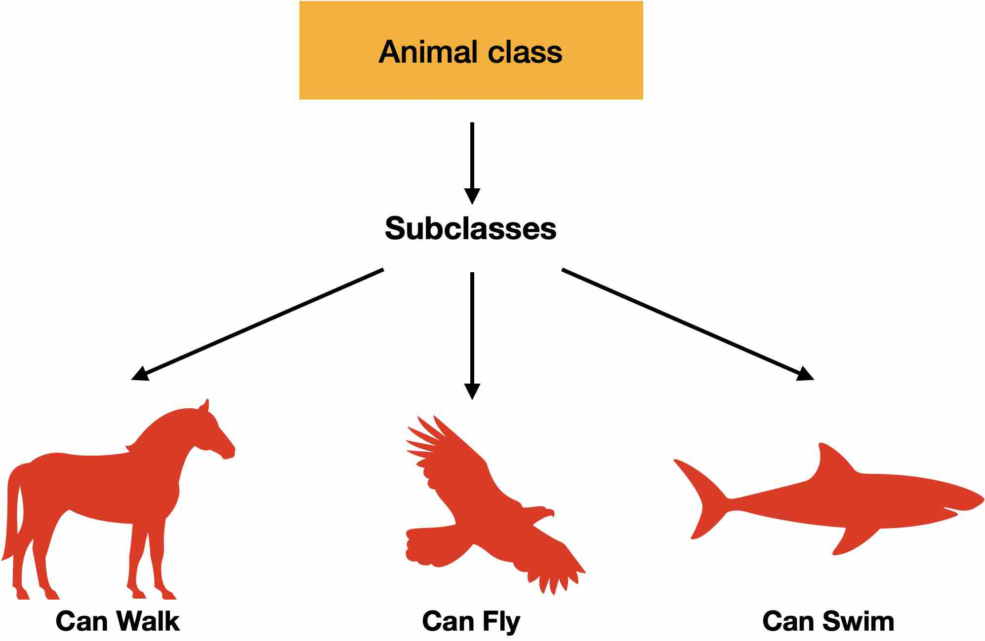
Class Inheritance
When we need to extend the existed class functionality and to add an extra features with a smart reuse of existed class – the solution is inheritance
In inheritance, the class that performs the inheritance called derived class and the one who we inherits (extends) from - called base class
The child class inherits all attributes of its parent class
A derived class can override any method of its base class, and a method can call the method of a base class with the same name
class DerivedClass (BaseClass1 [, BaseClass2, ...]):
'Optional class documentation string'
commands
Notes:
A set is defined as a unique collection of unique elements that do not follow a specific order.
Sets are used when the existence of an object in a collection of objects is more important than the number of times it appears or the order of the objects.
Unlike tuples, sets are mutable – they can be modified, added, replaced, or removed.
A sample set can be represented as follows:
set_a = {“item 1”, “item 2”, “item 3”,….., “item n”}
One of the ways that sets are used is when checking whether or not some elements are contained in a set or not.
For example, sets are highly optimized for membership tests.
They can be used to check whether a set is a subset of another set and to identify the relationship between two sets.

Slide 16
Class Inheritance – cont’d
Student Bank Account example:
class StudentBancAccount(BankAccount): def __init__(self, client_name, client_id, balance, college_name): BancAccount.__init__(self, client_name, client_id, balance) self.college_name = college_name def __str__(self): return "{} {}".format(BancAccount.__str__(self), self.college_name)
Notes:
In Visual Studio we’re able to view web pages. This is done by selecting “Web Browser” from the View menu (View --> Other Windows --> Web Browser) and typing the requested URL in the URL dropdown menu.
We can switch between tabs by clicking on the desired tab.

Slide 17
Class Inheritance – cont’d
Base method overriding can be done using super:
Note:
In python 3.x super syntax is much easier: super().__init__( ….)
isinstance(obj, type) - return true if the obj argument is an instance of the type argument, or of a subclass thereof.
class StudentBankAccount(BankAccount): def __init__(self, client_name, client_id, balance, college_name): super().__init__(client_name, client_id, balance) self.college_name = college_name
Notes:
In Visual Studio we’re able to view web pages. This is done by selecting “Web Browser” from the View menu (View --> Other Windows --> Web Browser) and typing the requested URL in the URL dropdown menu.
We can switch between tabs by clicking on the desired tab.

Slide 18
Lab 03

